Slide 1
List

Slide 2
Objectives
This chapter introduces:
  The one-dimensional list
  The two-dimensional list
  Methods of the list

Slide 3
list
In Python:
  A list is an ordered collection of objects
  In the list:
    The length of a list is changeable
    Use index values to display the data
  Use the [] symbol to create a list
    Each element of the list is separated by a comma
  List can store multiple data types, such as strings, integers, floating-point numbers, and etc

Slide 4
list
E.g:
# Declare a list
# Storing string, integer and floating point number
array=["Hello",123,10.5]
list representation | array[0] | array[1] | array[2]
index value | 0 | 1 | 2
data | Hello | 123 | 10.5

Slide 5
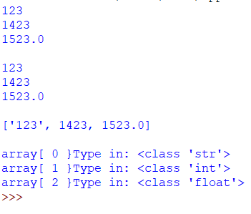
list
E.g:
Result:
array=["123",1423,1523.0] # Declare a list
#count=(0~<3) =>> 0,1,2
#Print the data of the list #method 1
for count in range(0,3):
print(array[count])
print()
# Print the data of the list #method 2
for elm in array:
print(elm)
print()
# Print the whole data of the list in a string #method 3
print(array,"\n")
# Display the type of each item in the list
for count in range(0,3):
print("array[",count,"} Type in:",type(array[count]))

Slide 6

list
When input is a string
  E.g:
Result:
  array =[]#Declare a list
  for counter in range(0,2): #Execute twice
  #Enter a string
  guess=input("Enter data: ")
  # Append the input data to the end of the list
  array.append(guess)
  for counter in range(0,2):
  print(array[counter])

Slide 7

list
When input is a number
E.g:
Result:
Result:
  array=[]#Declare a list
  for counter in range(0,2): #Execute twice
  #Enter a number
  #Convert the string to a number
  guess=int((input(" Enter data :")))
  # Append the number to the end of the list
  array.append(guess)
  for counter in range(0,2):
  print(array[counter])

Slide 8
list
The following example combines the use of if ... else ..., for loop, and while loop
  Select 1, you can enter 2 numbers and save them in the list
  Select 2, you can enter 2 string and save them in the list.
  After executing twice, the type of the data and the data in the list will be displayed

Slide 9
list
E.g:
  s=[]#Declare a list
  count=0#counter
  #Exit the loop after count == 2
  while(count!=2):
  check=int((input(" Enter 1 to add two numbers\
  \nEnter 2 to add two strings ")))
  #If you enter 1, add two numbers
  if(check==1):
  count=count+1
  for counter in range(0,2):
  #Convert string to number
  num=int((input(" Type in data ")))
  s.append(num)
  #If you enter 2, add two strings
  elif(check==2):
  count=count+1
  for counter in range(0,2):
  #Input string
  str=(input(" Type in data "))
  s.append(str)
#Display data in list
for counter in range(0,count*2):
print(s[counter])
#Display the data type in list
for counter in range(0,count*2):
print(type(s[counter]))

Slide 10
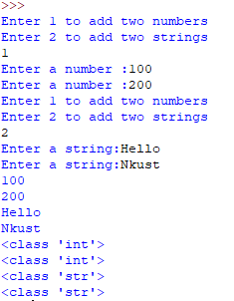
list
Result:

Slide 11
list
The following table describes a two-dimensional list
A two-dimensional list can also store different types of data
array[2][3] | 0 | 1 | 2
0 | array[0][0] | array[0][1] | array[0][2]
1 | array[1][0] | array[1][1] | array[1][2]

Slide 12

list
E.g:
Result:
  array= [[1, 2, 3], [4, 5, 6]]# two-dimensional list
  for counter1 in range(0,2):#list has 2 rows
  for counter2 in range(0,3):#list has 3 columns
  print(array[counter1][counter2],end = ' ')
  print("\n")

Slide 13
list
Most commonly used methods of list:
  append(), extend(), insert(), pop(), remove(), reverse(), sort()....

Slide 14
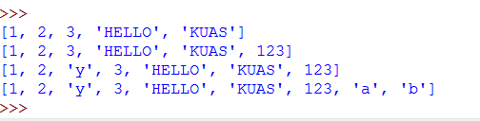
list
Result:
E.g:
  # Declare a list
  array = [1,2,3,"HELLO","KUAS"]
  print(array)
  #Insert an integer data at the end of the list
  array.append(123)
  print(array)
  #Insert the character ‘y’ at position 2 of the list
  array.insert(2, "y")
  print(array)
  #Append the elements ['a','b'] to the current list
  array.extend(['a', 'b'])
  print(array)

Slide 15
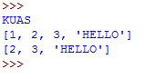
list
E.g:
Result:
  # Declare a list
  array = [1,2,3, "HELLO", "KUAS"]
  # Display the last element and removes it from the list
  print (array.pop ())
  # Display the remaining data in the list
  print (array)
  # Remove the element '1' from the list
  array.remove (1)
  # Display the remaining data in the list
  print (array)

Slide 16
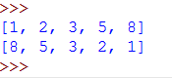
list
E.g:
Result:
  #Declare a list
  array = [1,8,2,5,3]
  # Sort the element in the list in an increasing order
  array.sort()
  print(array)
  # Use the "reverse" statement to reverse the data in a list
  array.reverse()
  print(array)

Slide 17
Sources
References:
  http://openhome.cc/Gossip/Python/IOABC.html
  http://www.pythondoc.com/pythontutorial3/introduction.htmlhttp://blog.eddie.com.tw/2011/10/13/python-list/
  http://openhome.cc/Gossip/Python/listType.html
  Python 深入淺出程式設計

Slide 18
Exercise 1
Design a program that will repeatedly ask the user to select 1, 2, 3, or 4, until -1 is selected.
  Select 1, execute append() to insert data into the list,
  Select 2, execute pop() to delete the last data of the list,
  Select 3, execute insert() to insert data in a specified list position,
  Select 4, execute remove() to remove the specified data,

Slide 19
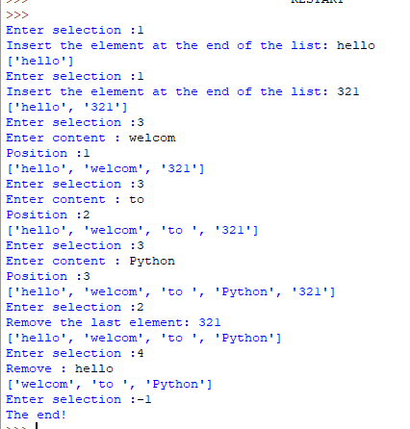
Exercise 2
Input:
1
1
3
1
2
4
1
2
-1
Result:

Slide 20
Exercise 3
Design a program that will ask the user to input a string and show if the string is palindrome or not, where palindrome is a string that can be written forwards or backwards while only showing itself.
Input
Madam
Anna
mannan
Output :
True
True
false

Slide 21
Exercise 4
Write a program and print the value of Q according to the given formula: Q = √ ([(2 * C * D) / H]) (in words: Q equals the square root of [(2 times C times D) divided by H]), where C (= 50) and H (= 30) are constants, and D is inputted from the user. Note that multiple values of D are separated by commas.
Input : 100,150,180
Output : 18,22,24
Suggestions:
  If the generated output has a decimal value, you need to round it to the nearest integer, for example 26.0 will be printed as 26.

Slide 22
Exercise 5
Write a Python program that accepts a hyphen-separated sequence of words as input and prints the words in a hyphen-separated sequence after sorting them alphabetically.
Input: green-red-yellow-black-white
Output: black-green-red-white-yellow

Slide 23
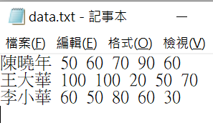

Exercise 6
Write a program that can read data, including student’s name and his five subject scores, from data.txt. Please output students’ data that are sorted in decreasing order of the average of the five subject scores.
Result:

